Slide 1
Public Assistance
Eligibility Review
Notes:
Instructor Note:
Explain that the following section defines the PA “eligibility pyramid”.

Slide 2
The PA Mission
The mission of FEMA’s PA Program is to provide assistance to State, Territorial, Indian Tribal, local governments, and certain types of Private Nonprofit (PNP) organizations so that communities can quickly respond to and recover from major disasters or emergencies declared by the President.

Slide 3
Today’s Objectives
Review PA Eligibility
Additional authorities and considerations as it pertains to Disasters
Be able to apply PA Eligibility as pertains to each Sector

Slide 4
Purpose of the Public Assistance (PA) Program
Provides Federal assistance when the magnitude of an incident or threatened incident exceeds the affected State, Territorial, Indian Tribal, and local government’s capabilities to respond or recover.
FEMA provides supplemental Federal disaster grant assistance for:
Debris Removal
Emergency Protective Measures
The restoration of disaster-damaged, publicly owned facilities and the facilities of certain Private Nonprofits (PNP).

Slide 5
Policies
Regulations
Law/Statute
Pyramid – Each block builds upon and requires the block below

Slide 6
Law/Statutes
Statutes are Federal laws passed by U.S. Congress and signed by the President. All PA Program assistance must comply with all applicable statutes.
The Robert T. Stafford Disaster Relief and Emergency Assistance Act, as Amended (Stafford Act), Title 42 of the United States Code (U.S.C.) § 5121
The law that authorizes the President to provide Federal assistance.
For FEMA to provide assistance, the President must declare that an emergency or major disaster exists.
The following sections of the Stafford Act specifically authorize the assistance FEMA provides under the PA Program:
Title I – Findings, Declarations and Definitions
Title III – Major Disaster and Emergency Assistance Administration
Title IV – Major Disaster Assistance Programs
  403, Essential Assistance
  406, Repair, Restoration, and Replacement of Damaged Facilities
  407, Debris Removal
  428, Public Assistance Program Alternative Procedures

Slide 7
The Declaration designates
Type of incident (e.g., hurricane, tsunami, or earthquake).
Emergency Declarations, an incident is any instance that the President determines warrants supplemental emergency assistance to save lives and protect property and public health and safety.
Major Disaster Declarations, an incident of any natural catastrophe.
Incident period
The incident period is the span of time during which the federally declared incident occurs. This period varies in length, depending on the incident.
Designated areas
The declaration designates which areas (e.g., county, parish, city, or Indian Tribal Government) are eligible to receive Federal assistance.
Types of assistance
FEMA defines which type of assistance it can provide to State, Territorial, Indian Tribal, and local governments and certain types of PNP organizations via its Public Assistance (PA) Program.

Slide 8
Regulations
Federal rules with the force and effect of law that implement a statute based on a Federal agency’s interpretation of that statute.
  Part 206 Subpart G, Public Assistance Project Administration
  Part 206 Subpart H, Public Assistance Eligibility
  Part 206 Subpart I, Public Assistance Insurance Requirements
  Part 207, Management Costs.

Slide 9
Public Assistance Policy
Public Assistance Program and Policy Guide (PAPPG) V3.1
FEMA issues policy to articulate the Agency’s intent and direction in applying statutory and regulatory authority. FEMA generally publishes proposed PA policy language in the Federal Register for public comment prior to publishing in this document.
FEMA applies this Version 3.1- dated April 2018, to incidents declared on or after August 23, 2017, i.e.
Purpose of the PAPPG is…….
Find the current Public Assistance Program and Policy Guide on line:
https://www.fema.gov/media-library/assets/documents/111781

Slide 10
Eligibility Pyramid
Cost
Work
Facility
Applicant
FEMA must determine each building block eligible, starting at the foundation (Applicant) and working up to the top of the pyramid (Cost).
Notes:
Instructor Note:
Identify the importance of referencing the Public Assistance Program and Policy Guide while functioning as a Program Delivery Manager. Refer participants to Chapter 2 or page 9 of the Public Assistance Program and Policy Guide.
Emphasize that a Program Delivery Manager must be familiar with the basics of eligibility to successfully identify issues and questions
The four basic components of eligibility are the (refer to the pyramid):
Applicant
Facility
Work
Cost
FEMA refers to these components as the building blocks of the eligibility pyramid. Generally, FEMA must determine whether each building block is eligible, starting at the foundation (Applicant) and working up to the top of the pyramid (cost).
Continued….
The Applicant is responsible for demonstrating that each component of the pyramid is eligible by providing supporting documentation.
FEMA accepts a variety of documentation to substantiate eligibility.
In some cases, FEMA requires specific documentation to support eligibility.

Slide 11
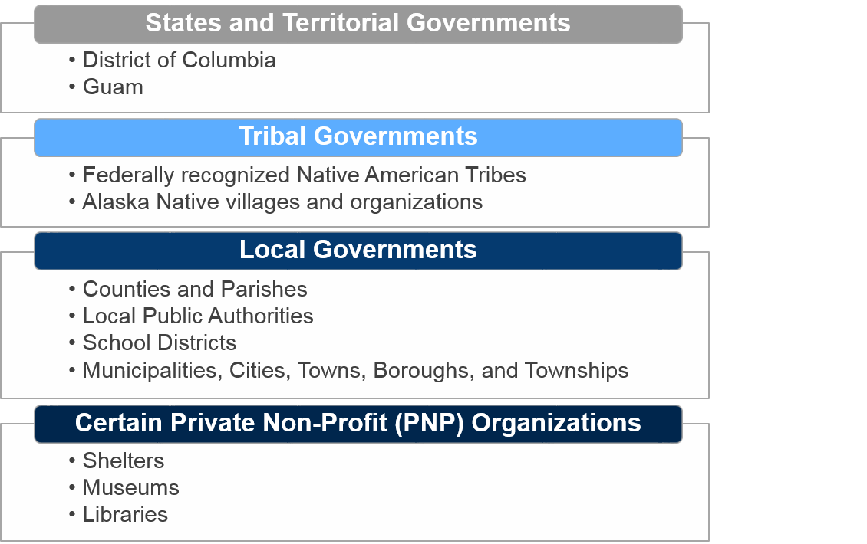
Types of Applicants
Notes:
Instructor Note:
The first step in assessing the eligibility of a project is determining whether the Applicant is eligible.
Applicant eligibility is determined by the Public Assistance Group Supervisor with input from the Office of the Chief Counsel.
Applicants include:
State and Territorial governments, including the District of Columbia, American Samoa, the Commonwealth of the Northern Mariana Islands, Guam, Puerto Rico, and the U.S. Virgin Islands, are eligible Applicants
Tribal Governments - Alaska Native Corporations are not eligible as they are privately owned
Local governments - Page 10 of PAPPG has a lit of eligible local governments:
Counties and parishes
Municipalities, cities, towns, boroughs, and townships
Local public authorities
School districts
Intrastate districts
Continued…
Councils of governments (regardless of whether incorporated as nonprofit corporations under State law)
Regional and interstate government entities
Agencies or instrumentalities of local governments
State-recognized Tribes
Special districts established under State law
Only certain Private Nonprofit Organizations are eligible Applicants, which is discussed on the following slide.

Slide 12
Private Nonprofit (PNP) Applicants
All PNP Applicants must meet the following criteria:
1
Have appropriate supporting documentation to establish non-profit status.
2
Be generally open to the public (critical PNPs do not need to be open to public).
Own/operate a facility that provides a critical service (e.g., education, utility, emergency, medical).
3
OR
Own/operate a facility that provides a non-critical, but essential governmental service.
PAPPG Reference: Review for additional information on PNP Applicants.
Notes:
Instructor Note:
Introduce the participants to the PNP application process.
For private non-profits, the facility must be eligible in order for the work to be found eligible.
For state, territorial, tribal, and local governments, the facility must be found eligible in order for the Permanent Work, temporary repairs, or mold remediation to be found eligible.
Facility eligibility is not applicable to other types of Emergency Work.
The PAPPG has PNP info from page 10-16 and a list of tables on pages 12-14 that list:
PNP eligible critical services
PNP eligible non-critical, essential government-type services
PNP ineligible services
Continued…
The difference between critical and non-critical is important, because for PNPs that provide non- critical, essential governmental services, FEMA only provides PA funding for eligible Permanent Work costs that a Small Business Administration (SBA) loan will not cover.
PNPs that provide critical services can apply directly to FEMA without having to apply to SBA.

Slide 13
Types of Facilities
What is a Facility?
Types of Facilities
A publicly or PNP-owned building, works, system, or equipment, built or manufactured, or an improved and maintained natural feature.
  A building is defined as at least having two walls and roof
  Groups of buildings are not “a facility”
Buildings
Federal Public Works
Roads
Systems
Equipment (built or manufactured)
Public Parks
PAPPG Reference: Review for additional information on types of facilities.
Notes:
Instructor Note:
Start by explaining to the participants what a facility is.
A facility is a building, public works, system, equipment (built or manufactured), or an improved and maintained natural feature.
An example of a system that qualifies as a facility is a water distribution system:
Components of a qualified facility include mechanical, electrical, plumbing, and other systems.
A natural feature is improved and maintained if it meets all of the following conditions:
The feature has designed and constructed improvements to its natural characteristics
The constructed improvement enhances the function of the unimproved natural feature
The Applicant maintains the improvement on a regular schedule to ensure the improvement performs as designed
Example: If 150 linear feet of a natural channel bank is armored with riprap and maintained, the eligible facility would be limited to the 150 linear foot section
Continued…
Question 1: What is an “improved and maintained, natural feature” is? (Or solicit examples from the class).
Designed and constructed improvement.
Improvement enhances function of natural feature.
Improvement is maintained regularly.
Additional examples include a terraced slope or realigned channel
Refer to the PAPPG, page 14 for more information: Emphasize to participants that only the sections of a natural feature that meet the criteria below are eligible.

Slide 14

Facility Eligibility
A facility is a building, works, system, or equipment, built or manufactured, or an improved and maintained natural feature.
An example of a system that qualifies as a facility is a water distribution system. Mechanical, electrical, plumbing, and other systems that are components of a facility in which they operate are considered part of that facility.

Slide 15
Eligibility Criteria for Facilities
1
To be considered eligible for funding, a facility must:
  Satisfy the definition of a facility.
  Maintenance of the facility must be the legal responsibility of the applicant.
  Be located in a designated disaster area.
  Not be under the authority of another Federal agency.
Generally, the following types of facilities are ineligible:
  Unimproved properties
  Land used for agricultural purposes
  Inactive facilities
2
Notes:
Instructor Note:
What do you need to consider when determining eligibility of a facility?
Satisfy the definition of a facility.
Be the legal responsibility of an eligible Applicant.
Be located in a designated disaster area.
Not be under the authority of another Federal agency.
What are ineligible facilities?
Unimproved properties such as a (e.g., a hillside or slope, forest, natural channel bank)
Land used for agricultural purposes
Inactive facilities

Slide 16
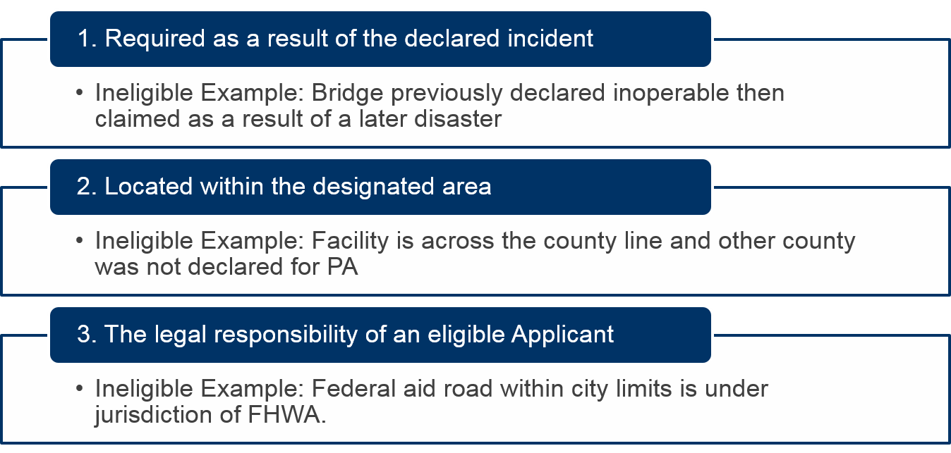
Minimum Work Eligibility Criteria
, i.e. road, building, sewer
CFR Reference: Review 44 CFR 206.223 for additional information.
Notes:
Instructor Note:
Participants should remember the basic, minimum work eligibility criteria below. At a minimum, work must meet one of the following criteria:
It has to be required as a result of the disaster.
It must be located within the designated area, with the exception of sheltering and evacuation activities.
It must be the legal responsibility of the Applicant.
Legal Responsibility Example
On September 13, 2008, heavy rain, wind, and storm surge from Hurricane Ike damaged beaches in the City of Galveston (Applicant).
Afterwards, the Applicant sought FEMA Public Assistance funding to repair punctured and deflated beach geotextile tubes (used to prevent erosion) and eroded sand dunes.
Continued…
FEMA representatives prepared several Project Worksheets (PWs) for the repair of the Applicant’s damaged facilities, including several geotextile tubes. However, FEMA did not prepare a PW for the geotextile tube located on one particular beach called Beachside Village Beach. FEMA determined that this one particular beach was ineligible because the City of Galveston was not legally responsible for this portion of the geotextile tube. In other words, the Applicant had “no obligation to enhance, maintain, repair or replace” the Facility.

Slide 17

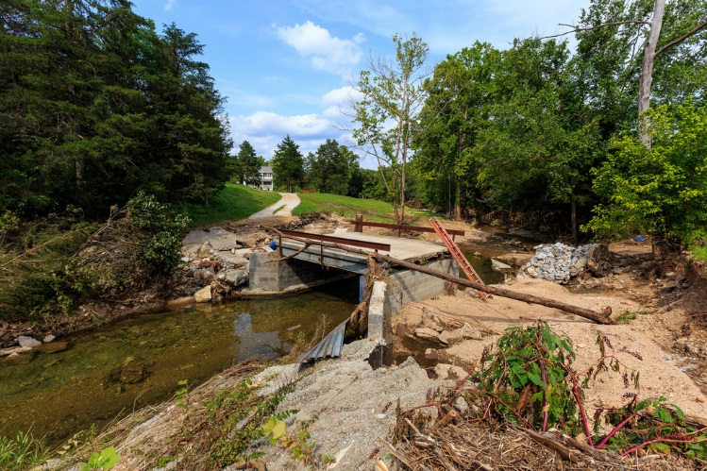
Maintenance
The Applicant must demonstrate that the damage was directly caused by the declared incident by providing:
  Pre-event photos
  Inspection reports
  Maintenance records
Why? 44 CFR 206-223 (a)(1): “to be eligible for Federal assistance, an item of work must be required as the result of the emergency or major disaster event.”
Notes:
Instructor Note:
Normal maintenance is not eligible. Work to repair potholes or fatigue cracking is generally ineligible as this type of damage is rarely caused directly by one incident.
Direct participants to Appendix K of the PAPPG and ask them to look over Roads and Bridges (page 190).
Ask if the participants have any questions.
Distinguishing between minor disaster-related damage and pre-existing issues resulting from a lack of maintenance can be difficult. The Applicant must demonstrate that the damage was directly caused by the declared incident by providing:
Pre-event photos.
Inspection reports.
Maintenance records.

Slide 18
Ineligible Work
FEMA does not provide PA funding for repair of damage caused by:
Deterioration
  Example: Alligator cracking of pavement on a road.
Deferred Maintenance
  Example: Bridge that previously failed its annual inspection, and no repairs were made to remediate.
Negligence
  Example: Mold that was not a result of the disaster.
1
2
3
In cases where ineligible damage, such as a pre-existing condition, if not repaired, may compromise repair of eligible damage, FEMA may make PA funding for repair of the eligible damage contingent upon the Applicant repairing the ineligible damage.
Notes:
Instructor Note:
Provide participants with some examples of “ineligible work” that FEMA will not provide PA funding for:
Deterioration
Example: Alligator cracking of pavement on a bridge.
Deferred Maintenance
Example: Bridge that previously failed pre-disaster inspection.
Negligence
Example: Mold that was not a result of the disaster.

Slide 19
Pre-Disaster Design
The capacity or function of a facility, as originally constructed or subsequently modified.
It is NOT the capacity at which the Applicant was using the facility at the time of the incident if different from the most recent designed capacity.
Notes:
Instructor Note:
Pre-disaster design is the capacity or function of a facility as originally constructed or subsequently modified.
It is not the capacity at which the Applicant was using the facility at the time of the incident if different from the most recent designed capacity.

Slide 20

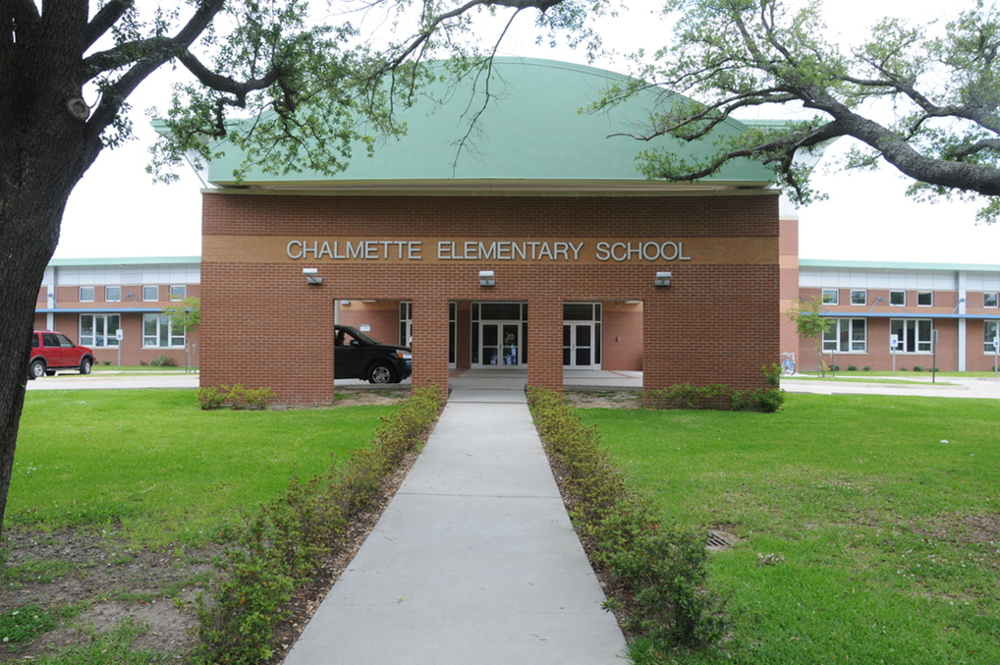
Pre-Disaster Design Example
If a school designed for a capacity of 100 students is damaged beyond repair, the eligible funding for the replacement facility is limited to that necessary for 100 students, even if more than 100 students were attending the school prior to the event.
Notes:
Instructor Note:
Discuss the example on the slide with the participants and ask if there are any questions.
Example: Restoring to Pre-Disaster Design.
If a school designed for a capacity of 100 students is damaged beyond repair, the eligible funding for the replacement facility is limited to that necessary for 100 students, even if more than 100 students were attending the school prior to the event.

Slide 21
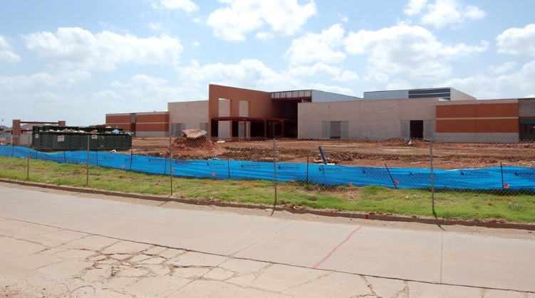
Pre-Disaster Function Example
The function for which the facility was originally designed or subsequently modified.
Notes:
Instructor Note:
For example, if an Applicant designed and constructed an administrative building, but later altered it in accordance with applicable construction standards to use as a school, the pre-disaster function would be as a school.
Pre-disaster function is the function for which the facility was originally designed or subsequently modified.
If the facility was serving an alternative function at the time of the incident, (but was not altered to provide that function) FEMA provides Public Assistance funding to restore the facility either to the original pre-disaster function or to the pre-disaster alternate function, whichever costs less.

Slide 22
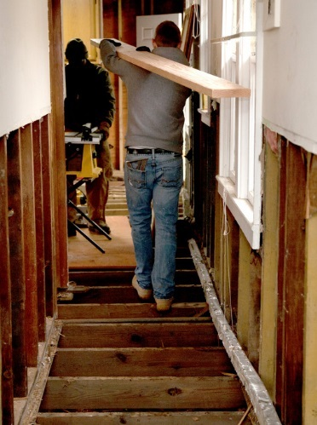
Changes to Facility
For the changes to be eligible, the Applicant must show that the changes are reasonable based on the type and extent of repair and consistent with the Applicant’s general construction practices. Building upgrades to meet codes and standards are also eligible.
Notes:
Instructor Note:
Public Assistance funding is always based on restoring to pre-disaster design and function.
For the changes to be eligible, the Applicant must show that the changes are reasonable based on the type and extent of repair and consistent with the Applicant’s general construction practices.
Some examples include work required to tie in to existing infrastructure or work necessitated by site conditions, access issues, or availability of materials.

Slide 23
Codes and Standards
FEMA provides PA funding to restore facilities on the basis of pre-disaster design and function in conformity with current applicable codes, specifications, and standards.
Eligibility Criteria
Applies to the type of restoration required
Is appropriate to the pre-disaster use of the facility
Is reasonable, in writing, formally adopted by the State, Territorial, Tribal, or local government, and implemented by the Applicant on or before the declaration date, OR is a legal Federal requirement
Applies uniformly
Was enforced during the time it was in effect

Slide 24
Applies to the Type of Restoration Required
Codes and standards must apply to the type of restoration required.
If FEMA determines a facility is not eligible for replacement, only code-required upgrades applicable to repairs are eligible.
A code or standard may include a trigger that requires:
Upgrades to all structural components
In addition to upgrading all structural components, bringing the non-structural components into conformance with current codes or standards for new construction
* If an upgrade to an entire structural or non-structural system within a building is triggered, the upgrade is only eligible if there is a direct relationship between the upgrade work and eligible damage. Only upgrade work within the same system as the damage is eligible.

Slide 25
Examples of Codes or Standards that Do Not Apply to the Restoration Required
An Applicant requests PA funding for the repair of a damaged building and the construction of a parking garage. The Applicant states that while there was no parking garage prior to the incident, zoning codes and other local ordinances require one. Because parking improvements have no relationship to the disaster-related repairs, they do not apply to the type of restoration required and are not eligible.
Similarly, if a code or standard that applies to new construction or the rehabilitation of an entire road requires the construction of paved shoulders, drainage swales, and berms, the construction of these improvements is not eligible for a project involving repairs to discrete damaged portions of the road shoulders.

Slide 26


Appropriate to Pre-disaster Use
Codes and standards must be appropriate to the pre-disaster use of the facility.
FEMA determines the eligibility of code required upgrades based on the facility’s pre-disaster design or actual use at the time of the disaster
The least costly of the following
  Pre-disaster use of the facility, if serving the same function for which it was originally designed; or
  Alternate use of the facility, if serving an alternate function at the time of the incident.
PAPPG Reference: Review for additional information on types of facilities.

Slide 27
Example of a Code or Standard that Is Not Appropriate to the Pre-disaster Use of the Facility
The original design of a facility was a warehouse; however, the Applicant was using the facility as a classroom before the incident. Restoring the facility as a classroom in conformance with classroom codes or standards would not be eligible if it would be more costly than restoring the facility as a warehouse in accordance with code or standards applicable to a warehouse.

Slide 28
Codes and standards must be reasonable
FEMA determines whether the upgrade and trigger relate to the type of restoration required by the damage and whether the upgrade and trigger are justified based on the extent of damage.
FEMA may determine a very large upgrade based on a very low trigger to be unreasonable.
Example of Reasonableness
Installation of a code or standard-required new sprinkler system throughout a building is eligible if that building is replaced. However, installation of that sprinkler system is not eligible if the eligible work only involved repair of the building, even if required by the code or standard, unless it is reasonable based on the eligible repair.

Slide 29


Applies Uniformly
Codes and standards must apply uniformly to all similar types of facilities, whether private or public, eligible or ineligible, in the Applicant’s jurisdiction or (if applicable) in a particular hazard zone within its jurisdiction.
For FEMA to find that a code or standard and its triggers are uniformly applied, the code or standard must meet all of the following conditions. The code or standard must:
  Provide for uniform accountability in the event of noncompliance
  Not be subject to discretionary enforcement by public officials
  Not allow for selective application
PAPPG Reference: Review for additional information on types of facilities.

Slide 30
Written, Formally Adopted, and Implemented.
Codes and standards must be in writing, formally adopted by the State, Territorial, Tribal, or local government, and implemented by the Applicant on or before the declaration date, OR be a legal Federal requirement, such as a requirement of ADA or seismic safety.
The code or standard must apply to the facility in question.

Slide 31
Enforced
The code or standard must have been enforced during the time it was in effect.
Example of a Code or Standard that Was Not Enforced While in Effect
An Applicant requests funding to upgrade the foundation of several damaged trailers based on a code requirement applying to repairs to trailers and installation of new trailers. The Applicant installed several new trailers after the incident and did not use the code or standard-required foundation. The upgrades to the foundation of the damaged trailers are not eligible because the Applicant did not enforce the standard.

Slide 32
Additional Work Due to Standards
If a permitting agency requires additional work based on a standard that does not meet the eligibility criteria in the PAPPG, the cost of the additional work is only eligible if the work:
  Does not change the pre-disaster design, capacity, or function of the facility.
  Applies to the type of repair or restoration required.
  Is reasonable based on the type and extent of damage.
  Is an established, enforced, uniform practice that applies to all similar types of facilities within the Applicant’s jurisdiction.
1
2
3
4
Notes:
Instructor Note:
Public Assistance funding is always based on restoring to pre-disaster design and function.
Explain to the participants the red flags they may see in Permanent work.

Slide 33

Cost Eligibility
To be eligible, costs must be:
  Directly tied to the performance of eligible work
  Adequately documented
  Reduced by all applicable credits, such as insurance proceeds and salvage values
  Authorized and not prohibited under Federal, State, Territorial, Tribal, or local government laws or regulations
  Consistent with the Applicant’s internal policies, regulations, and procedures that apply uniformly to both Federal awards and other activities of the Applicant
  Necessary and reasonable to accomplish the work properly and efficiently

Slide 34

Cost Eligibility continued…
A cost is reasonable if, in its nature and amount, it does not exceed that which would be incurred by a prudent person under the circumstances prevailing at the time the Applicant makes the decision to incur the cost.
FEMA determines reasonableness by evaluating whether:
The cost is of a type generally recognized as ordinary and necessary for the type of facility or work.
The cost is comparable to the current market price for similar goods or services based on:
  Historical documentation
  Average costs in the area
  Published unit costs from national cost estimating databases

Slide 35

Cost Eligibility continued…
Any of the following factors caused escalation of costs:
Shortages in equipment, materials, supplies, labor, or contractors. When escalating costs are due to shortages, FEMA considers whether the Applicant’s work continued beyond the period of shortages and whether there was an opportunity for the Applicant to obtain more reasonable pricing
Project-specific complexities, such as environmental or historic issues, remote access or location, provision of a unique service with few providers, or elements requiring an extraordinary level of effort
The Applicant deviated from its established practices
Exigent circumstances existed. If so, FEMA evaluates the length of time the circumstances existed compared to the length of time costs were incurred
The Applicant participated in ethical business practices, ensuring parties to a transaction are independent of each other, without familial ties or shared interests and on equal footing without one party having control of the other
The Applicant complied with procurement requirements

Slide 36

Cost Eligibility continued…
Labor Policies
FEMA will determine whether the number of hours claimed are reasonable and necessary by evaluating:
The severity of the incident
Whether the work was performed at a time when it was necessary to work extraordinary hours based on the circumstances of the incident
The function of the employee for which the hours are claimed
The number of consecutive hours the employee worked
            Regular Time for Debris Removal Projects
            Alternate Procedure: Eligible
            Standard Program: Ineligible

Slide 37

Cost Eligibility continued…
Procurement and Contracting Requirements
FEMA provides PA funding for contract costs based on the terms of the contract if the Applicant meets Federal procurement and contracting requirements.
Procurement Guidance for Recipients and Sub-recipients
Under 2 C.F.R. Part 200

Slide 38

Cost Eligibility continued…
Procurement Standards
Federal procurement standards for State and Territorial governments are different than those for Tribal and local governments and PNPs. State and
Territorial government Applicants must follow the same policies and procedures they would use for procurements with non-Federal funds
Non-State Applicants (Tribal and local governments and PNPs) must use their own documented procurement procedures that reflect applicable State, Territorial, Tribal, and local government laws and regulations, provided that the procurements conform to applicable Federal law and standards.
FEMA PA staff coordinate with FEMA’s Office of Chief Counsel when evaluating whether the Applicant complied with Federal procurement requirements. In the case of non-compliance with Federal procurement requirements, FEMA determines a reasonable cost for the eligible work completed based on all available information and documentation.

Slide 39

Ineligible Costs
The Stafford Act authorizes FEMA to provide PA funding for specific work performed as a result of the incident. It does not authorize FEMA to provide PA funding for all losses or costs resulting from the incident.
Costs that are not Eligible:
  Loss of Revenue
  Loss of Useful Service Life
  Tax Assessment
  Increased Operating Costs
    However, short-term increased costs that are directly related to accomplishing specific emergency health and safety tasks as part of emergency protective measures may be eligible.

Slide 40
FEMA Required Minimum Codes and Standards
FEMA generally requires that the Applicant incorporate the natural hazard-resistant codes and standards and related provisions referenced in the most recent published edition of the International Code Council’s (ICC), International Building Code (IBC), International Existing Building Code (IEBC), or International Residential Code (IRC) into the building design and construction. This includes natural hazard-resistant provisions, such as tornado, wind, seismic, and flood as identified in the IBC, IEBC, or IRC regardless of the type of incident that caused the damage.
These codes and standards must apply to the type of restoration required (e.g., repair or construction), be appropriate to the pre-disaster use of the facility, and be reasonable.
Non-compliance may result in denial or de-obligation of PA funding for the facility.

Slide 41
Utilities (Category F)
Conductor Replacement
For electrical transmission or distribution systems, determining the disaster-related damage to some components, such as poles, guys, and cross-arms, can usually be accomplished by visual inspection. However, determining the full extent of disaster-related damage to conductors is more challenging, particularly with older systems.
A line section is a group of contiguous spans selected for evaluation. A span is the distance between two poles or structures.
An Applicant has flexibility in defining a line section. A line section can be:
A single span
All the spans between two dead-end structures
All the spans on a feeder
All the spans on a tap
Any other group of contiguous spans that are evaluated together

Slide 42
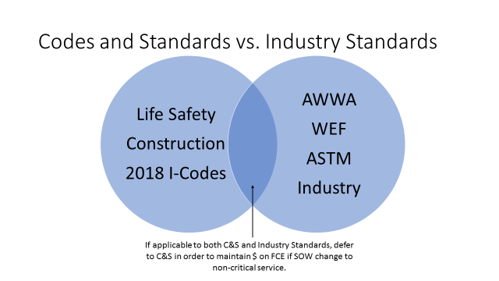

Slide 43
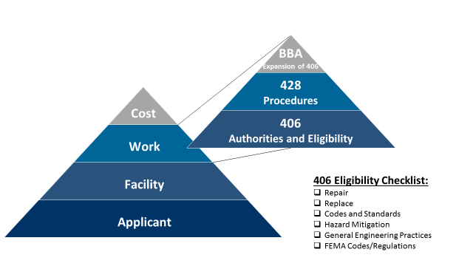

Slide 44
Ineligible Upgrades
Upgrades recommended by design standards, guidelines, policies, industry practices, or other non-mandatory provisions are not eligible if the provisions do not meet all of the criteria noted in Chapter 2:VII.B.1. Upgrades that are deemed ineligible, but enhance a facility’s ability to resist similar damage in a future incident, may be eligible as hazard mitigation.

Slide 45
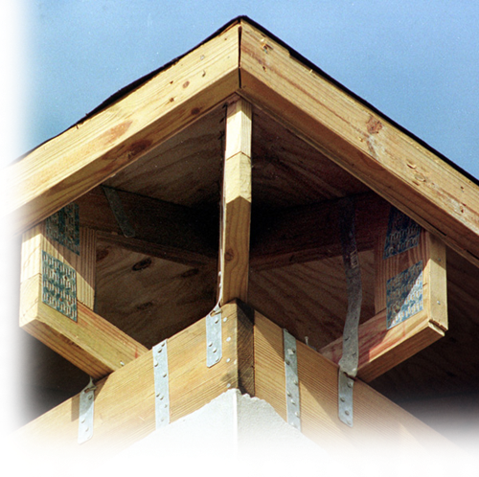
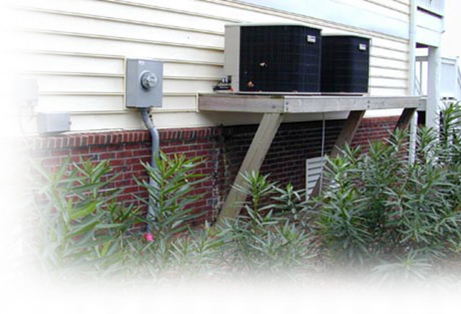
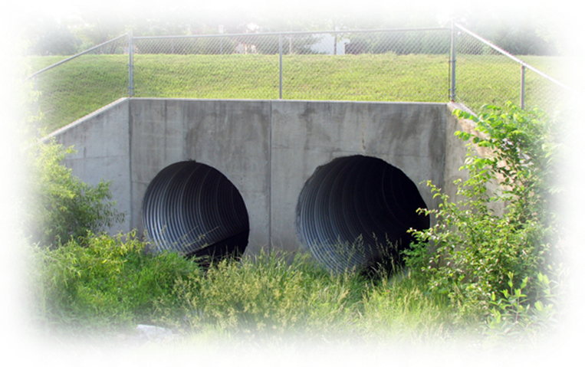
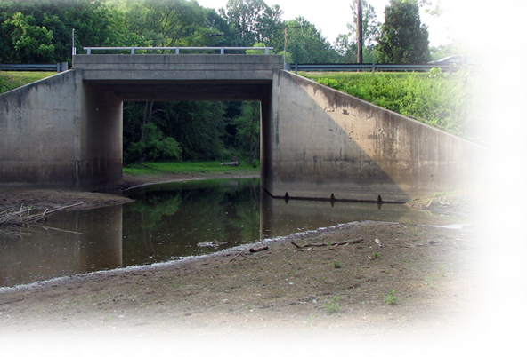
406 Mitigation
Authorities and Eligibility

Slide 46
Hazard Mitigation
Hazard mitigation is any sustained action taken to reduce or eliminate long-term risk to people and property from natural hazards and their effects. FEMA has authority to provide PA funding for cost-effective hazard mitigation measures for facilities damaged by the incident.
To be eligible, the mitigation measures must directly reduce the potential of future, similar damage to the facility.
If FEMA approves mitigation funding and the Applicant does not complete the mitigation work, FEMA will de-obligate the mitigation funds.

Slide 47
FEMA Hazard Mitigation Programs

Slide 48
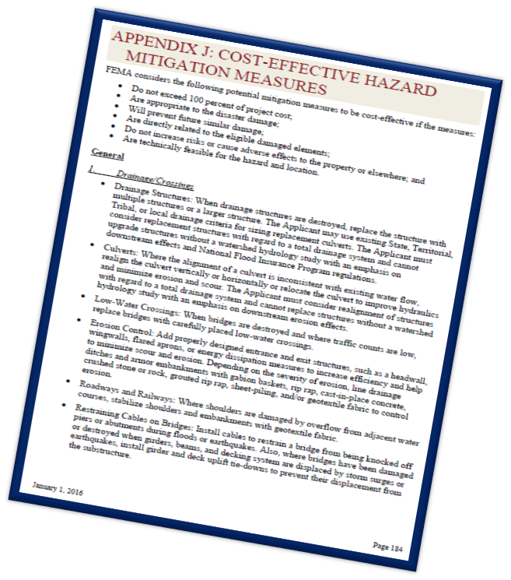




FEMA Regulations and Requirements
Stafford Act Section 406
44 CFR Section 206.226(e)
Title 2 CFR Section 200
PA Program & Policy Guide
FP104-009-2, Appendix J
PAPPG Reference: Reviewe 190 for additional information on types of facilities.

Slide 49
Eligibility Considerations by Facility
Appendix K details the types of facilities captured within each category of work along with specific eligibility criteria related to one or more of the facilities within each category.

Slide 50
PA Alternative Procedures for Permanent Work Section 428
Sector-based Recovery Organization
  In alignment with the National Disaster Recovery Framework, the Puerto Rico JRO is taking a sector-based approach in supporting Puerto Rico by coordinating recovery resources across the federal interagency, private sector, and nongovernmental organizations.
FEMA Program Staff Roles and Responsibilities
  The Solution Based Team(s) within each Sector will convene key partners and develop recovery strategies that work toward unified outcomes, and ultimately enable the application of the right resource to the right need.
Integration with Hazard Mitigation Grant Program
  The recovery efforts in Puerto Rico are seeking to align implementation of hazard mitigation under the Public Assistance program and the HMGP. Grant funding under the HMGP must be prioritized toward protecting federal investments in Puerto Rico’s public infrastructure.
Notes:
A. Sector-based Recovery Organization
In alignment with the National Disaster Recovery Framework, the Puerto Rico JRO is taking a sector-based approach in supporting Puerto Rico by coordinating recovery resources across the federal interagency, private sector, and nongovernmental organizations. Each Sector will identify key partners, assess the impacts, identifying resource needs and priorities, convene key partners to form solution-based teams, develop proposed solutions (or courses of action), finalize solutions that are effective, resilient, mutually supportive, and determine available funding mechanisms and lines of effort to complete proposed work. Ultimately all contributors will move away from the concept of a project-based recovery to a solution-based recovery where importance is placed on the unified solution versus an individual program and/or project.
B. FEMA Program Staff Roles and Responsibilities
The Solution Based Team(s) within each Sector will convene key partners and develop recovery strategies that work toward unified outcomes, and ultimately enable the application of the right resource to the right need. Through this collaborative effort, funds from the federal interagency, private sector, and nongovernmental organizations will be brought to bear in executing solution based team outcomes. Eligible funds through FEMA grant programs are one of a variety of funding sources that will be available to Puerto Rico in recovery.
FEMA program staff will report directly to the FEMA Sector Lead. In addition, Public Assistance, Mitigation, and EHP subject matter experts facilitate the overall processes and provide a policy advisory role, reporting directly to the FCO/FDRC and/or Deputy Directors.
Integrating FEMA program staff within each Sector enables the agency to provide unified support to Subrecipients as program specialists in Public Assistance, Mitigation, and EHP will work together from day one by attending site visits, reviewing risks, and identifying any potential environmental or historic preservation impacts to inform and influence efficient project formulation and facilitate the identification of mitigation opportunities and reviews for environmental compliance, decision making, and grant execution.
EHP Leads and Specialists will be cross-trained in Public Assistance and Hazard Mitigation to provide them with a better understanding on how the full project formulation/development process works.
PA Operations Support and PA Policy Team (along with Mitigation and EHP operations cells) support the operational execution components for all project worksheets (PWs), correspondence and ensure program integrity by providing program guidance and as needed policy interpretation.
C. Integration with Hazard Mitigation Grant Program
The recovery efforts in Puerto Rico are seeking to align implementation of hazard mitigation under the Public Assistance program and the HMGP. Grant funding under the HMGP must be prioritized toward protecting federal investments in Puerto Rico’s public infrastructure. Mitigation staff will be cross-trained in understanding hazard mitigation under the Public Assistance program and Hazard Mitigation Grant Program (HMGP), as defined in Sections 406 and 404 of the Stafford Act. Mitigation staff bring technical expertise in risk analysis and benefit cost analysis, and can provide recommended feasible, effective, and cost effective mitigation actions that reduce risk. Rather than FEMA’s grant programs driving solutions, Subrecipients will work with the Solution Based Team to identify their solutions, and Mitigation staff will then determine eligibility under Public Assistance (Section 406) and/or the Hazard Mitigation Grant Program (Section 404). Appendix A includes considerations for the Solutions Based Teams to better understand grant requirements under the HMGP.

Slide 51
PAPP Section 428 continued…
D. Unified Federal Review Process
  The Unified Federal Review (UFR) process aims to coordinate EHP reviews across the federal interagency to expedite planning and decision-making for disaster recovery projects.
E. Inclusive Whole Community Approach
  Disability Integration personnel are FEMA trained to serve as advisors on the elimination of barriers to equal access. These barriers may be found in communication, physical, or programmatic access.
Notes:
D. Unified Federal Review Process
The Unified Federal Review (UFR) process aims to coordinate EHP reviews across the federal interagency to expedite planning and decision-making for disaster recovery projects. EHP program staff within each Sector will work with the JRO’s UFR Advisor and Sector Leads to identify where broader compliance activities should or may be coordinated to enhance efficiency in delivering assistance to the Recipient and Subrecipients. Such coordination may include creation of interagency agreements for streamlining processes between resource/regulatory agencies. The UFR Advisor will work with relevant program staff and Sector Leads in facilitating compliance reviews with the resource/regulatory agencies where needed.
E. Inclusive Whole Community Approach
Disability Integration personnel are FEMA trained to serve as advisors on the elimination of barriers to equal access. These barriers may be found in communication, physical, or programmatic access. The elimination of these barriers creates a whole community approach which is inclusive of individuals with disabilities, their families and others with access and function needs. Disability Integration staff will serve as subject-matter experts, providing training and technical assistance, to help carry out FEMA’s responsibility for equal access under applicable laws and authorities.

Slide 52
Bipartisan Budget Act (BBA)
Requirements
Applicability – To establish the parameters of applicability of this policy and the special authority that it implements.
Eligible Industry Standards – To identify and apply the relevant industry standards for purpose of repair, restoration, or replacement authorized by the special BBA authority.
Eligible Work and Cost – To establish effective and consistent eligibility standards for purposes of implementing the special BBA authority.

Slide 53
BBA continued
Use of Funds
1. If the Applicant wishes to use these funds toward an Alternate Project, the Alternate Project must still provide a SBA-eligible critical service and must be constructed to an approved industry standard(s). FEMA will evaluate the proposed use for reasonableness to ensure funds are used in an appropriate manner based on the intent to improve the resiliency ofthe critical services defined in the BBA.
2. The BBA does not preclude incorporation of hazard mitigation. Section 406 and 404Hazard Mitigation opportunities will be evaluated after FEMA determines the BBA eligible work.

Slide 54
ADDITIONAL INFORMATION
1. Critical Services: Power, water, sewer, wastewater treatment, communications, education, emergency medical care, and emergency services.
2. Facility: An individual piece of equipment, individual building, or other independent structure inclusive of any interconnected components.
3. System: An interconnected network of components that work together to function, such as a wastewater treatment plant. A campus of buildings is not a system.
4. Site: An individual facility inclusive of its contents and supplies or, in the case of systems, each section of piping from manhole to manhole, node to node, each lift station, manhole structure, control building, clarifier, sedimentation pond, or power line section or span (e.g., line from pole to pole, section of line between two dead-end structures, all the spans on a feeder or tap, or a group of contiguous spans that must be evaluated together).
5. Industry Standard: A formally documented practice or generally accepted requirement used to establish uniform engineering or technical criteria, methods, and processes that are followed by members of the industry. These standards are considered to be acceptable, or correct by members of the industry, as well as regulators and governing bodies.

Slide 55
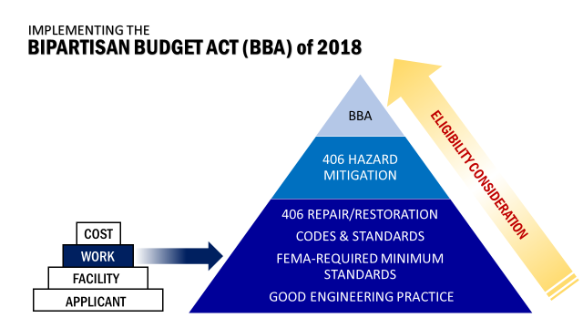

Slide 56
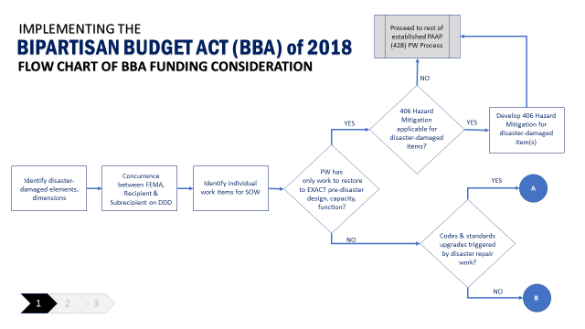

Slide 57
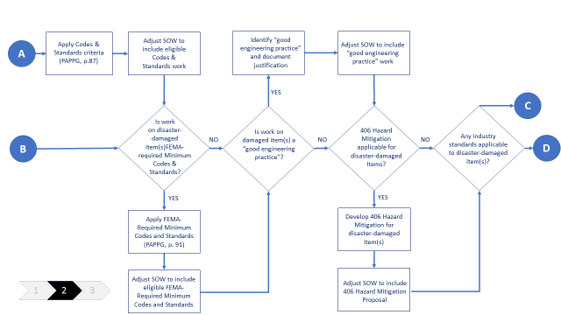

Slide 58
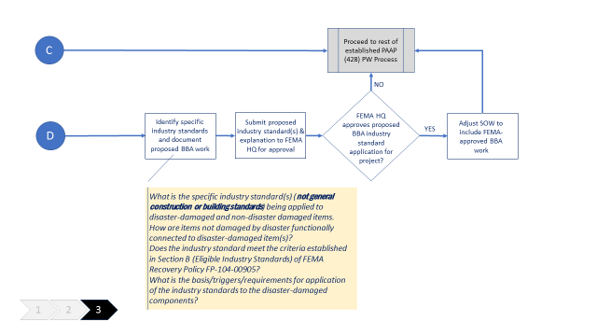

Slide 59
Activity Scenario 1
In August, a hurricane made landfall along the east coast. An eligible private non-profit (PNP) homeless shelter was severely damaged in a declared jurisdiction such that the facility was rendered inaccessible. The PNP owned and operated the facility, and had to relocate temporarily while the damage could be repaired.
Activity
In this case, would the temporary relocation be eligible for Public Assistance (PA) funding? Why or why not?
Notes:
Instructor Note:
Ask participants to research Applicant of described scenario to determine if they are eligible and why. Participants will be asked to reference the PAPPG and explain their reasoning.
In August, a hurricane made landfall along the east coast. An eligible private non-profit (PNP) homeless shelter was severely damaged in a declared jurisdiction such that the facility was rendered inaccessible.
The PNP owned and operated the facility, and had to relocate temporarily while the damage could be repaired.
In this case, would the temporary relocation be eligible for Public Assistance (PA) funding? Why or why not?

Slide 60
Activity Scenario 2
In August, a hurricane made landfall along the East Coast. A road was flooded and it resulted in the need for emergency barricades, to protect public safety.
Activity
In this case, would the emergency barricades be eligible for Public Assistance (PA) funding? Why or why not?
Notes:
Instructor Note:
Have participants research eligibility of described projects to determine if they are eligible and why. Participants will be asked to reference the PAPPG and explain their reasoning.
In August, a hurricane made landfall along the East Coast. A road was flooded and it resulted in the need for emergency barricades, to protect public safety.
In this case, would the emergency barricades be eligible for Public Assistance (PA) funding? Why or why not?

Slide 61
Activity Scenario 3
In August, a hurricane made landfall along the East Coast necessitating the use of an Emergency Operations Center (EOC) to direct and coordinate the response activities. The Applicant did not have a designated EOC so they had to lease a facility. Additionally, they had to purchase supplies to operate the facility, including meals for the individuals manning the facility.
Activity
In this case, would the lease and supplies (including meals) be eligible for Public Assistance (PA) funding? Why or why not?
Notes:
Instructor Note:
Have participants research eligibility of described projects to describe if they are eligible and why. Participants will be asked to reference the PAPPG and explain their reasoning.
In August, a hurricane made landfall along the East Coast necessitating the use of an Emergency Operations Center (EOC) to direct and coordinate the response activities. The Applicant did not have a designated EOC so they had to lease a facility. Additionally, they had to purchase supplies to operate the facility, including meals for the individuals manning the facility.
In this case, would the lease and supplies (including meals) be eligible for Public Assistance (PA) funding? Why or why not?

Slide 62
Knowledge Check: Scenario 1
County B experienced a flood that resulted in damage to the basement of the county’s courthouse. Many boxes of files and several computers were partially damaged, necessitating the recovery of the damaged hard-copies and the recovery of data from the water-damaged hard drives.
In this case, would the required labor and equipment be eligible for Public Assistance (PA) funding? Why or why not?
Notes:
Instructor Note:
Encourage participation.
County B experienced a flood that resulted in damage to the basement of the county’s courthouse. Many boxes of files and several computers were partially damaged, necessitating the recovery of the damaged hard-copies and the recovery of data from the water-damaged hard drives.
In this case, would the required labor and equipment be eligible for Public Assistance (PA) funding?
Why or why not?

Slide 63
Knowledge Check: Scenario 2
Township D claims that a hurricane deposited a significant amount of debris and silt in a storm water retention base. The Applicant told FEMA that prior to the incident the facility had no debris or silt buildup and was regularly maintained. They were able to provide the as-built plans of the basin showing the elevations of the bottom of the basin but they were unable to provide any documentation supporting regular maintenance or to support the pre-disaster sedimentation levels.
In this case, is the restoration of the storm water detention basin eligible? Why or why not?
Notes:
Instructor Note:
Encourage participation.
Township D claims that a hurricane deposited a significant amount of debris and silt in a storm water retention base. The Applicant told FEMA that prior to the incident the facility had no debris or silt buildup and was regularly maintained.
They were able to provide the as-built plans of the basin showing the elevations of the bottom of the basin but they were unable to provide any documentation supporting regular maintenance or to support the pre-disaster sedimentation levels.
In this case, is the restoration of the storm water detention basin eligible?
Why or why not?

Slide 64
Knowledge Check: Scenario 3
A flood caused significant damage to many of the roads throughout Township F, including damage to the surfaces, bases, and shoulders. A federal highway running through the town was damaged.
In this case, are the repairs to the federal highway eligible?
Notes:
Instructor Note:
Encourage participation.
A flood caused significant damage to many of the roads throughout Township F, including damage to the surfaces, bases, and shoulders. A federal highway running through the town was damaged.
In this case, are the repairs to the federal highway eligible?

Slide 65
BBA Scenario 1 - Work
There is a code that was adopted in PR, prior to the December, 2018 that states that all health care facilities must have sprinklers installed by 2019. Under standard PA, the installation of the sprinklers would not be eligible, as the work is not required as the result of the event – the installation of the sprinklers was not triggered by the repair of disaster damage.
Can FEMA fund this work using BBA authorities? BBA policy says nothing about installing NEW systems. It does address replacing or upgrading undamaged components, but not adding components.
The policy says: “repair or replacement of components not damaged by the disaster are only eligible if work is required to restore the critical service function of the facility or system to an approved industry standard.”

Slide 66
BBA Scenario 2 - Work
An Applicant has a combined sewer system that was damaged during the event. Can FEMA fund replacement of the damaged combined sewer systems with separate sanitary sewer line and a storm water sewer line?
A Policy Statement by the American Society of Civil Engineer’s (ASCE) states; “ASCE recognizes the problems inherent with combined sewer systems, including the environmental and health risks from overflow conditions. Historically, combined sewers were an acceptable technology for collecting storm water, sanitary sewage and industrial effluents in a single conduit for discharge to water courses. This practice is no longer acceptable because of today’s understanding of the environmental and health risks imposed by this practice.”
Do Cities in CONUS, with combined sewer systems, have any standards or guidelines to address this (generally look in Northeast and Great Lakes Regions) New York, Philadelphia, and Atlanta? Yes, there are local design guidelines with triggers that define when combine sewer systems should be replaced with separate sewer and water lines and the guidelines are relatively consistent.
Notes:
When applying the site definition are there sites meeting LP threshold with disaster damage? YES
Does the damage at the sites meet the triggers in the local design guidelines? YES
Can FEMA fund the replacement of the combined sewer systems with separate sewer and storm water lines at each site that met the threshold?
Can the system function to industry standards without replacing the non-damaged sites? NO Some non-damaged sections must also be replaced – those directly connected and part of a system within the entire system must also be replaced and we could fund that under BBA, but are not able to replace the entire system. Must look at the damaged sites and how they relate to the un-damaged sites.

