Slide 1
Training, Testing, and Exercise (TT&E)
April 16, 2019

Slide 2
Presenter:
Robert Baldwin
State Recovery Planner
Kentucky Emergency Management

Slide 3
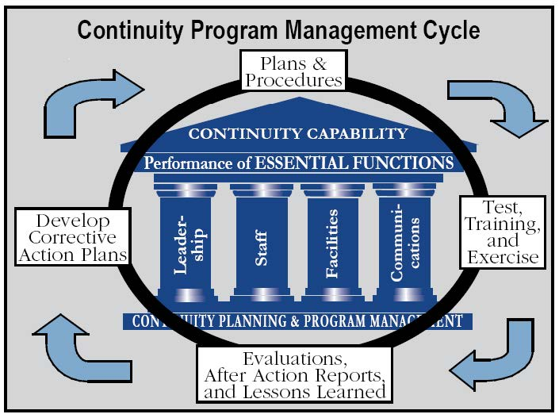
COOP Planning Process

Slide 4
Training, Testing, & Exercise (TT&E)
All-hazard TT&E Program must be established to maintain the agency’s COOP capability
Continuous TT&E of personnel, equipment, systems, processes, and procedures
Incorporate lessons learned
Measures to ensure that an agency’s COOP program is capable of supporting the continued execution of its essential functions throughout the duration of the COOP event

Slide 5
TT&E (cont’d)
Major components of a TT&E include:
Training all leadership and staff of their COOP responsibilities
Conducting periodic exercises to test and improve COOP Plans, procedures, systems, and equipment
Instituting a multi-year planning process to ensure continual plan updates in response to changing conditions

Slide 6
Definitions
Training – Instruction in individual or agency functions, procedures, and responsibilities
Exercise – An instrument to train for, assess, practice, and improve performance in prevention, protection, response, and recovery capabilities in a risk-free environment
Testing – Serves to assess and validate all the components of continuity plans, policies, procedures, systems, and facilities used to ensure continuance of essential functions and identify issues for subsequent improvement
Evaluation – A post-exercise analysis

Slide 7
Goals of TT&E
Ensure all agency employees know their roles following COOP plan activation
Verify the COOP plan and designated recovery systems actually work
Clarify where COOP plan needs revision or additional information
Build team unity and resiliency
Communication network practice
Individual performance improvement
Reveal resource gaps

Slide 8
Goals of TT&E (cont’d)
Agencies can ensure that:
All equipment and systems work as required
Employees are able to deploy to the alternate facility within the required framework
The alternate facility includes everything needed for the response team to perform the agency’s essential function

Slide 9
Building a TT&E Program
Perform a Capabilities Assessment
Review COOP plan for potential weaknesses and shortfalls
Identify what capabilities would strengthen those weaknesses
Consider what tasks must be performed to achieve the identified capabilities
Design exercises to improve the agency’s ability to complete those tasks

Slide 10
Building a TT&E Program (cont’d)
4-Step Cycle in Exercise Program Management
Budget Management: identifies expenditures associated with planning for and conducting exercises
Exercises: includes the design, development, conducting, and evaluation of exercises
Monitoring and Reporting: establishes a means of monitoring compliance to ensure program requirements are met
Improvement Planning: ensures exercise process doesn’t lose its effectiveness by developing a plan to incorporate recommended improvement into subsequent exercise cycles

Slide 11
Building a TT&E Program (cont’d)
Exercise Planning Team
Determines exercise objectives, creates scenarios, and develops exercise documentation
Develops and distributes pre-exercise materials (i.e. agendas, invitations, press releases for media, etc.)
Serves as point of contact for exercise participants
Conducts exercise briefings and training sessions
Recruits and trains facilitators and evaluators

Slide 12
Exercises
An agency’s exercise program should include and document:
Compliance with HSEEP, as appropriate
An annual opportunity for key employees to demonstrate their familiarity with COOP plans and procedures
A biennial exercise for key employees to demonstrate their familiarity with the reconstitution procedures
A biennial exercise for employees to demonstrate their familiarity with devolution procedures
A comprehensive debriefing/hot wash after each exercise

Slide 13
Exercises (cont’d)
An agency’s exercise program should include and document:
A cycle of events that incorporates evaluations, AARs, and lessons learned into the development and implementation of a Corrective Action Program (CAP)
A CAP to assist with documenting, prioritizing, and resourcing continuity issues

Slide 14
What to Exercise
Full spectrum of COOP operations
Alert, notification, and activation
Relocation to alternate facilities
Operations
Logistical support, services, and infrastructure to alternate facility
Devolution
Reconstitution

Slide 15
Testing
Testing is critical for:
Alert, notification, and activation procedures
Communication systems
Vital records and databases
Information technology systems
Reconstitution procedures
Other aspects dependent on agency

Slide 16
Testing (cont’d)
An agency’s testing program should include and document:
Annual testing of alert, notification, and activation procedures
Annual testing of recovery strategies for essential records, critical information systems, services, and data
Annual testing of the capabilities for protecting essential records and information systems
Annual testing of primary and backup infrastructure systems and services at continuity facilities
Annual testing and exercising of required physical security capabilities at continuity facilities

Slide 17
Testing (cont’d)
An agency’s testing program should include and document:
Quarterly testing of the internal and external interoperability and viability of communications equipment and systems
Annual exercise of the capabilities required to perform an agency’s essential functions
Annual testing of telework capabilities, to include IT infrastructure
Annual exercise of internal and external interdependencies

Slide 18
Trainings
An agency’s training program should include and document:
Annual continuity awareness briefings or other means of orientation for the entire workforce
Annual training on the roles and responsibilities for personnel
Annual training for the agency’s leadership on that agency’s essential functions
Annual training for all agency’s personnel designated within the orders of succession for Agency Head r other key positions

Slide 19
Trainings
An agency’s training program should include and document:
Annual training for those officials listed within the delegations of authority on all pre-delegated authorities for making policy determinations and other decisions
Periodic briefings to managers about the essential records program

Slide 20
Example of Trainings
COOP awareness briefing for entire workforce
Team training for COOP Team personnel
Team training for agency personnel assigned to activate, support, and sustain COOP operations
Cross-Training for agency personnel in case essential functions must continue with reduced staff

Slide 21
Example of Trainings (cont’d)
Below are examples of additional types of training new and existing personnel, both key and supportive, may receive:
Introduction to COOP planning
COOP plan activation and relocation
Cross-training for essential functions
National Incident Management System
Incident Command System

Slide 22
Initial COOP Training
The first training should be conducted to:
Introduce general concepts of COOP
Announce staff assignments, roles, and responsibilities
Present general procedures
Describe COOP testing, exercise, and timeframes

Slide 23
COOP Planning Process Revisited

Slide 24
Establish Review Cycle
Annually review COOP policies and procedures
PLUS
After each exercise / testing of major systems
Issues arising from training
Corrective Actions

Slide 25
Maintenance Tasks
Train key individuals and teams
Conduct regular / refresher COOP exercises covering a variety of hazards and types of training
Institute multi-year process to ensure regular updates

Slide 26
COOP Plan Maintenance Schedule

Slide 27
Questions?

Slide 28
Webinar Schedule:
DATES TOPICS
March 12 Identifying Essential Functions
March 19 Essential Personnel and Lines of Succession
March 26 Communications
April 2 Alternate Facilities and Vital Records
April 9 Devolution and Reconstitution
April 16 Training, Exercise, and Plan Maintenance

Slide 29
To access past presentations, please visit:
https://kyem.ky.gov/programs/Pages/Planning.aspx

Slide 30
To request assistance, advice,
or schedule consultations, contact:
Robert Baldwin
KYEM – State Recovery Planner
Office: (502) 607-1989
Cell: (502) 226-0153
robert.e.baldwin87.nfg@mail.mil

