Slide 1
WELCOME TO THE 1ST QUARTER
SEARCH AND RESCUE
LEADERSHIP FORUM
January 20, 2015
1:00 PM – 4:00
State Emergency Operations Center
Notes:
Facilitator: Greg Shanks

Slide 2
WE WILL BEGIN IN 5 MINUTES.
PLEASE TAKE YOUR SEAT.
Notes:
Facilitator: Greg Shanks

Slide 3
WELCOME TO THE
SEARCH AND RESCUE
LEADERSHIP FORUM
Notes:
Facilitator: Greg Shanks – Introduce Director Dossett

Slide 4
KYEM Director Michael Dossett
Welcome to the State EOC
Back to Basics Philosophy
Business Model Building Blocks
Why Are You Here Today?
Expectations of the Leadership Forum
Search and Rescue Committee
Call To Action
Notes:
Welcome – General greeting, everyone sign-in and get handouts (agenda, committee information sheet, survey results) provide a general acknowledgement to the committee and Rich who are sitting in the Op’s Area.
Back to Basics – For SAR this means we need to focus efforts on creating and sustaining squads within counties to support local and regional needs.
Why are you here today? Take some answers from participants. Use this question as a building block for tying in the need for an organized effort lead by the SAR Committee. How can the SAR program help you build the capability that prepares your community for the risks that are most relevant and urgent? How can we as a SAR community work together to ensure each county in the Commonwealth achieves this capability?
Committee – Brief outline of the work the committee will be doing. Stress the committee will operate under their own direction and bring solutions to the KYEM Director and SAR Coordinator. The committee serves as your voice. Invite all to become involved by interacting with the committee and providing feedback on proposed changes. Maintaining and enhancing the SAR program is a shared responsibility that call for the involvement of all partners.
Expectations of the Leadership Forum - A forum is a meeting, or medium where ideas on a particular issue can be exchanged. Later on we will get a chance to have an exchange of ideas on what is working and what needs repaired. Down the road we will come together at these forums to build upon the work that is accomplished each quarter. Before we do that we have to establish priorities with the SAR Program. This forum serves as your opportunity to provide constructive input for this process.
This is our 1st meeting in approx 18 months. Meetings will now occur every quarter. We will be moving the Forum around the State. We are currently looking for sites to host the 3rd and 4th Quarter. If you are interested please see Rich Knighten.
Call to Action - From a local point of view - help to identify what you see as the program's challenges, strengths, threats and opportunities. (Opportunity to reference survey results that will be reviewed next).

Slide 5
State EOC Building
26,150 square foot facility that houses the following functions:
State’s Emergency Operations Center
The State’s 24-hour Warning Point
Six breakout rooms provide work areas for functional teams
Data Center and offices
Media Room
Executive Conference Room
Offices for Operations and Planning Branches
Kentucky National Guard Joint Operations Center
Notes:
Rich Knighten

Slide 6
State EOC Building Specifications
Building is designed to withstand a 250 MPH wind load
Redundant sources of electrical power
Enhanced communication grounding standards
Building meets the anti-terrorism standards
Raised floor access for system wiring
Increased work area from 34 seats to 123 seats
Notes:
Rich Knighten

Slide 7
State of Search and Rescue Program
Legislative Requirements
ECIC – Incident Call-in and Capability Requests
Operational Support
Quarterly Reporting
Training and Exercise
Notes:
Rich Knighten
Statutory Requirements – Get back to basics by doing what is required. Legislative and regulation revisions
ECIC – Data collection – KYEM is going to increase data sharing. A goal is to be in a position to provide mutual aid based upon specific capability requests.
Operational Support – How the State SAR Coordinator supports incidents
Training – Introduce and recognize Jason Sanderson

Slide 8
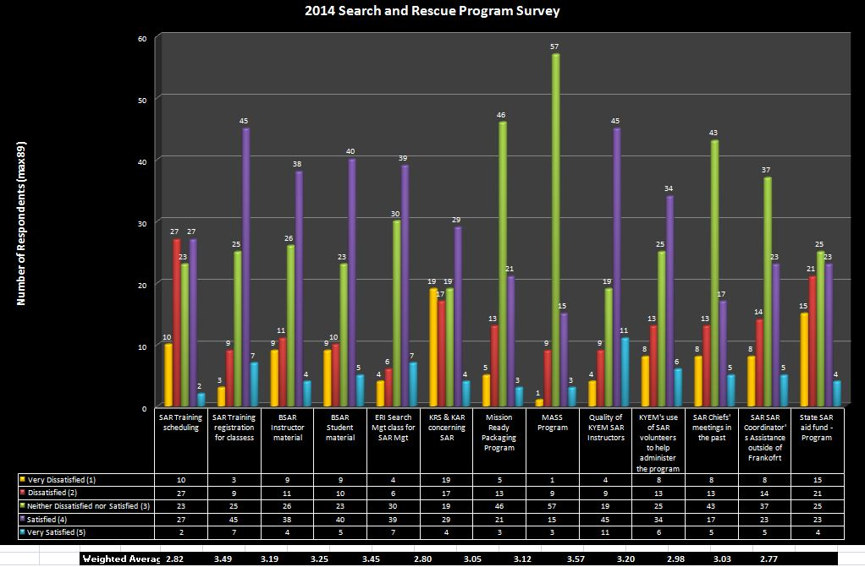
2014 SAR Survey
Notes:
Rich Knighten
-Refer to handout everyone received.
Results will be published on our website.

Slide 9
2014 SAR Survey – Summarization of Comments
Prioritization of the SAR Program within the Division
Course Curriculum – adoption of national standards
SAR Training Schedule / Class Minimum / Advanced Course Offerings
Why has the SAR Rescue Aid Fund amount decreased?
Instructor Training and Qualification Program
KRS / KAR revisions to coincide with today’s technology
Inadequate cooperation between EM and Fire Commission on recognizing each others programs.
Notes:
Rich Knighten

Slide 10
SFY 15 Rescue Aid Fund
Amount Available – $80,000 (state only funds)
Application Process
Advisory Committee
Evaluation Process
Applications Received: (24)
Awards – (19) – Total Obligated $80,000
Notes:
Greg Shanks

Slide 11
SFY 15 Rescue Aid Fund
Squad | Amount | General Description
Bath Co SAR | $6,842 | Minimum equipment
Buffalo Trace SAR | $8,309 | Water Rescue equipment
Grand Paws SAR Dog | $5,195 | Trailer for response equipment and rain gear
Hardin Co SAR | $4,275 | Mobile radios, portable generator
Harrison Co SAR | $3,575 | Handheld GPS units, Kenwood TK radios
Jefferson Search Dog Assoc | $3,245 | Generator, computer, printer
Knott Co Fire & Rescue | $330 | Minimum – headlamps
Lee County SAR | $294 | Minimum equipment
Magoffin County SAR | $ 10,590 | UTV and accessories
McCracken County SAR | $1,836 | Boat trailer
Morgan County SAR | $3,495 | Honda inverter / generator
Owen Co SAR | $1,870 | Road safety gear
Notes:
Greg Shanks

Slide 12
SFY 15 Rescue Aid Fund
Squad | Amount | General Description
Rough Terrain SAR | $3,239 | GPS and water rescue items
Campbellsville Rescue | $8,909 | Inflatable shelter, portable light scene, generator
Trigg County Rescue | $2,432 | Minimum equipment
Trimble County SAR | $470 | Minimum equipment
Wayne County SAR | $6,303 | Light bars, voice pagers
Wolfe County | $5,376 | Technical rope rescue equipment
Woodbine SAR | $4728 | Minimum equipment
Notes:
Greg Shanks

Slide 13
Search and Rescue Committee
12 member committee appointed by the KYEM Director
Diverse background and experiences
Committee works independent of KYEM Leadership – Will call upon practitioners for technical assistance and advice
Focuses on coordinating solutions to overcoming challenges and threats, seeks new opportunities for growth and embraces areas of strength.
All incidents, including SAR missions, start local and end local. The program framework must complement this school of thought.
Notes:
Rich Knighten

Slide 14
TAKE A 10 MINUTE NETWORKING BREAK
Notes:
Greg Shanks

Slide 15
Search and Rescue Committee
Alex Hyrcza, Chair
Rick Weber, Deputy Chair
Hugh Caldwell
Shawn Harron
Gregg Bayer
Eric Seibel
Bart Powell
Tim Cooley
Nee Jackson
David McGill
Don Franklin
Jerry Rains
Notes:
Director Dossett

Slide 16
SAR Committee Mission Statement
The Commonwealth of Kentucky Search and Rescue Committee will advocate the needs of the rescue squads and will communicate with and advise the Commonwealth’s Search and Rescue Coordinator.

Slide 17
SAR Committee Vision Statement
The committee strives to promote a professional state-wide search and rescue program through these core values:
Integrity
Safety
Technical Proficiency
Dedication
Standardization
Discipline
Notes:
Alex Hyrcza
Next committee will focus on by-laws and framework.
Creation of a 2-3 year SAR Program Plan

Slide 18
SAR Committee
Roles and Responsibilities
Rick Weber
Notes:
Rick Weber

Slide 19
SAR Sub-Committee
Roles and Responsibilities
Alex Hyrcza
Notes:
Alex Hyrcza

Slide 20
SAR in the Commonwealth
Past, Present, Future
Alex Hyrcza & Committee
Notes:
Alex Hyrcza with comments from the Committee

Slide 21
TAKE A 10 MINUTE NETWORKING BREAK
Notes:
Greg Shanks

Slide 22
Town Hall Meeting Parameters
Raise your hand to be recognized.
A facilitator will come to you.
One person at a time will have the
floor. Please be respectful of others
& keep comments constructive.
Find a speaker console on the desks.
Provide your name and squad.
Push the “Speaker” button to talk (red light comes on) - Push again to turn off (red light goes off)
Notes:
Greg Shanks, Lead Facilitator
Facilitators in the audience: Jason Sanderson, Junior Lewis, Terry Varney

Slide 23
Announcements
Participant feedback form will be emailed.
Apply to be considered for a Sub-Committee
2nd QR Leadership Forum
April 18, 2015
Hosted by Floyd County Rescue
Alexander-Goble-Willis Training Center
Seeking locations for the 3rd and 4th Quarter Forums
Notes:
Alex Hyrcza

