Slide 1
A Team of Teams – With One Mission:
“Protecting Our Commonwealth”

Slide 2
August 20, 2014 HazMat Tabletop Exercise (TTX)

Slide 3
Housekeeping
“A Team of Teams – With One Mission: Protecting our Commonwealth”
Sign-In Sheet
Emergency Exits
Cell Phones/Radios
Personal Calls
Break Room
Bathrooms
Smoking
Unbridled Pursuit of Excellence

Slide 4
Agenda
“A Team of Teams – With One Mission: Protecting our Commonwealth”
9:00 AM- Welcome/Framing Inject
9:10 AM- Incident Command to Unified Command
10:10 AM- Unified Command to Incident Command
11:11 AM- Closing of Incident
12:10 PM- Hot Wash
12:30 PM- End of Exercise
Unbridled Pursuit of Excellence

Slide 5
Purpose
“A Team of Teams – With One Mission: Protecting our Commonwealth”
The purpose of this exercise is to allow
multi-agency collaboration in building an Incident Command to Unified Command and best practices document.
Unbridled Pursuit of Excellence

Slide 6
Scope
“A Team of Teams – With One Mission: Protecting our Commonwealth”
This exercise is a Tabletop Exercise (TTX), planned for three hours and thirty minutes at the State Emergency Operations Center. The August 2014 HazMat TTX will explore the conditions that require transitions from an Incident Command to a Unified Command, a Unified Command to an Incident Command, and conditions that require closing an incident.
Unbridled Pursuit of Excellence

Slide 7
Capability
“A Team of Teams – With One Mission: Protecting our Commonwealth”
Operational Coordination
Unbridled Pursuit of Excellence

Slide 8
Objectives
“A Team of Teams – With One Mission: Protecting our Commonwealth”
Describe how an incident transitions from Incident Command to Unified Command transition.
Describe how an incident transitions from Unified Command to Incident Command transition.
Describe how an incident is closed.
Unbridled Pursuit of Excellence

Slide 9
Exercise Structure
“A Team of Teams – With One Mission: Protecting our Commonwealth”
This exercise will be a multimedia, facilitated exercise. Players will participate in the following three modules.
Module 1: Incident Command to Unified Command
Module 2: Unified Command to Incident Command
Module 3: Closing an Incident
Unbridled Pursuit of Excellence

Slide 10
Exercise Guidelines
“A Team of Teams – With One Mission: Protecting our Commonwealth”
This exercise will be held in an open, low-stress, no-fault environment. Varying viewpoints, even disagreements, are expected.
Respond to the scenario using your knowledge of current plans and capabilities (i.e., you may use only existing assets) and insights derived from your training.
Decisions are not precedent setting and may not reflect your organization’s final position on a given issue. This exercise is an opportunity to discuss and present multiple options and possible solutions.
Issue identification is not as valuable as suggestions and recommended actions that could improve response and protection efforts. Problem-solving efforts should be the focus.
Unbridled Pursuit of Excellence

Slide 11
Assumptions and Artificialities
“A Team of Teams – With One Mission: Protecting our Commonwealth”
The exercise is conducted in a no-fault learning environment wherein capabilities, plans, systems, and processes will be evaluated.
The exercise scenario is plausible, and events occur as they are presented.
All players receive information at the same time.
In order to answer some of the discussion questions in this exercise, it is assumed that the weather incident has evolved and time has moved forward. Facilitators will explain the evolution of the scenario to their participants.
Unbridled Pursuit of Excellence

Slide 12
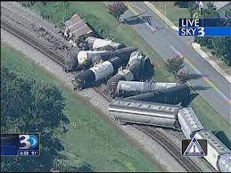
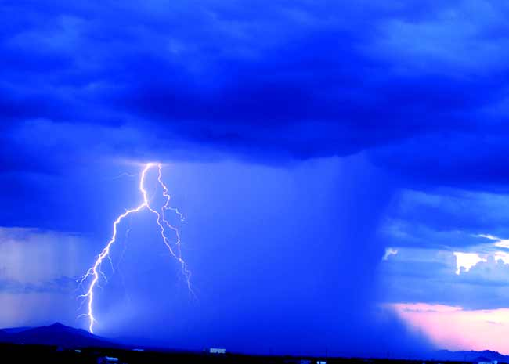
Module One
“A Team of Teams – With One Mission: Protecting our Commonwealth”
UPDATE
Unbridled Pursuit of Excellence

Slide 13
Scenario
“A Team of Teams – With One Mission: Protecting our Commonwealth”
Wednesday August 20, 2014 – 7:30 am EST : Day One
August 20th, 2014 at approximately 7:30am EST a train derailed in Fayette County .46 miles South of the Bryan Station and Briar Hill Road interchange. The derailed train consists of 57 rail cars, but only 13 have derailed. The train originated in Western, KY and was en route to Eastern, KY. The following agencies are onsite: Local Fire, EMS, and Police. Access control has been established.
Locals have called State Duty Officers and the following agencies are en route: Law Enforcement, Local EM, Regional Hazmat Team, Railroad Response Team, KYEM Regional RRM, KYTC, DEP, KSP, EPA. This will be a 24-48 hour operation. IC to UC has determined the Operational Period to be 12 hours.
An initial assessment by local responders shows that there is a leaking chemical. The chemical is determined to be HF. Hazmat team has made initial entry and confirmed HF is the leaking tank. The 2nd Hazmat team has attempted plugging operations which failed due to poor structural integrity of the tank.
Unbridled Pursuit of Excellence

Slide 14
Toxic Threat Zone
August 20, 2014 0730 hours EDT
Chemical Name: Hydrofluoric Acid (HF)
WARNING: Can react with water and or vapor. This can affect the evaporation rate and downward dispersion.
Wind: 5 Miles/hours E at 3 meters
Air Temperature: 95 Fahrenheit and 35Celsius
Cass Number: 7664-39-3 Liquid
THREAT ZONE
AEGL: 3 (red) greater than 44 ppm [60 min]
AEGL: 2 (orng) greater than 24 ppm [60 min]
AEGL: 1 (blk) greater than 01 ppm [60 min]

Slide 15
Toxic Threat Zone
August 20, 2014 0730 hours EDT
Chemical Name: Hydrofluoric Acid (HF)
WARNING: Can react with water and or vapor. This can affect the evaporation rate and downward dispersion.
Source Strength: Tank is 100% Full
Tank Diameter: 8 feet
Tank Volume: 7,520 gallons
Chemical Mass: 28.7 tons
Opening Length: 15 inches
Opening: 2 feet from tank bottom
Release Duration: 3 minutes

Slide 16
Toxic Threat Zone
Hydrofluoric Acid CAS No. 7664-39-3 UN/NA No. 1790 DOT Hazard Label CHRIS Code Corrosive Poison HFA A colorless fuming mobile aquenos solution with a pungent odor. Corrosive to metals and tissue. Highly toxic by ingestion and inhalation. Exposure to fumes or very short contact with liquid may cause severe painful burns; penetrates skin to cause deep-seated ulceration that may lead to gangrene.
Diamond | Hazard | Value | Description
0 4 1 | Health | 4 | Can be lethal.
 | Flammability | 0 | Will not burn under typical fire conditions.
 | Instability | 1 | Normally stable but can become unstable at elevated temperature and pressures.
 | Special

Slide 17
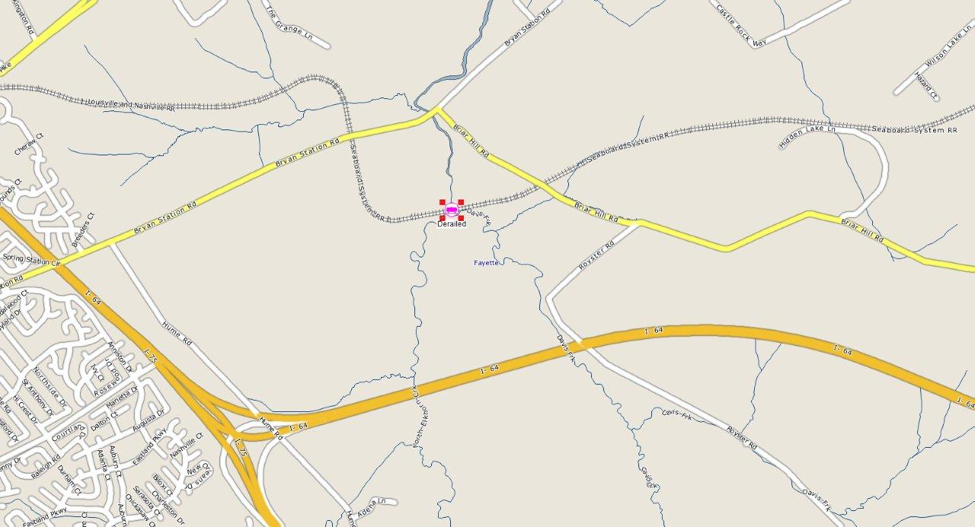
August 20, 2014 HazMat TTX

Slide 18
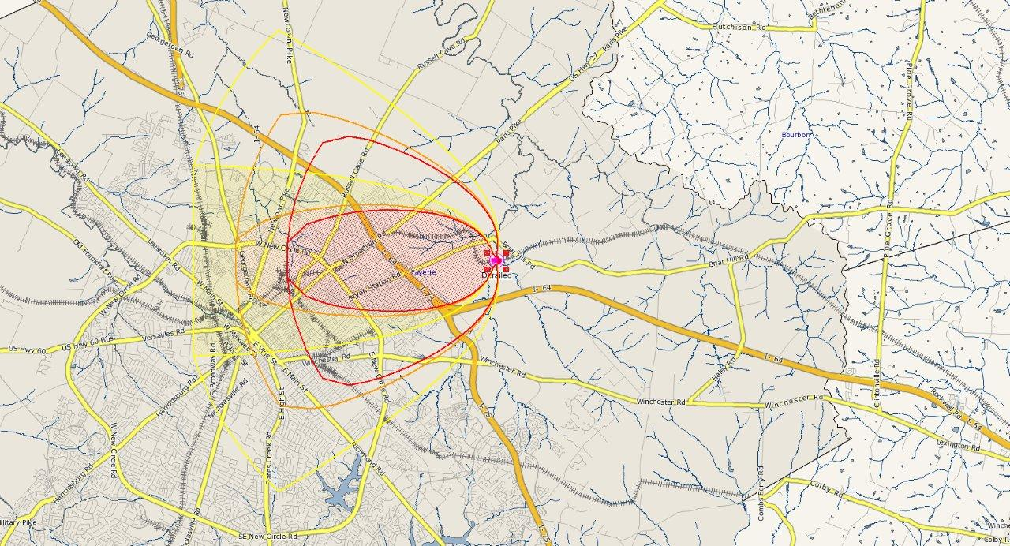
August 20, 2014 HazMat TTX

Slide 19
Questions
“A Team of Teams – With One Mission: Protecting our Commonwealth”
Module 1 - Triggers that suggest a transition from IC to UC
How will multiple Operational Periods impact command structure?
How is command structure impacted when multiple agencies with regulatory or statutory authority respond to an incident?
How is command structure impacted when the incident complexity and scope exceed the management capabilities of a single Incident Command?
How is command structure impacted when multiple jurisdictions are involved in the incident response?
Unbridled Pursuit of Excellence

Slide 20
Module Two
“A Team of Teams – With One Mission: Protecting our Commonwealth”
Unbridled Pursuit of Excellence

Slide 21
Scenario
“A Team of Teams – With One Mission: Protecting our Commonwealth”
Thursday August 21, 2014 – 2:30 pm EST – Day Two
Unified Command Brief:
The contents of the damaged (HF) derailed car has been off-loaded. The remaining cars have been prepared for salvage. Within the next four hours we will begin salvage operations of the derailed cars and repair of tracks. DEP remains on scene to evaluate soil contamination.
Unbridled Pursuit of Excellence

Slide 22
Key Ideas
“A Team of Teams – With One Mission: Protecting our Commonwealth”
Key Ideas from Briefing – Module 2
Determine and Validate Triggers for UC to IC transition.
Determine and Validate Procedures in UC to IC transition.
Determine and Validate IC Operations.
Unbridled Pursuit of Excellence

Slide 23
Questions Module 2
“A Team of Teams – With One Mission: Protecting our Commonwealth”
Triggers that suggest a transition from a Unified Command to an Incident Command
How is command structure influenced as the danger from an incident decreases and agencies with regulatory or statutory authority withdraw from on-scene response activities?
How does a decrease in multiple Operational Periods impact the command structure of an incident?
How does the Unified Command transition to an Incident Command?
When is the Safety Officer no longer needed? Are there any other positions that should stay behind?
Describe your demobilization plan for those agencies not participating in the Incident Command.
Explain who writes and implements the Demobilization Plan. When does this process begin?
Unbridled Pursuit of Excellence

Slide 24
Module Three
“A Team of Teams – With One Mission: Protecting our Commonwealth”
Unbridled Pursuit of Excellence

Slide 25
Scenario
“A Team of Teams – With One Mission: Protecting our Commonwealth”
Thursday August 22, 2014 – 9:00 am EST – Day 3
Briefing from Incident Commander:
August 22, 9:00am EST. Salvage operations are wrapping-up. Railroad personnel are beginning the process of restoring rail lines. Environmental clean-up has begun with contractor on-scene.
Unbridled Pursuit of Excellence

Slide 26
Key Ideas
“A Team of Teams – With One Mission: Protecting our Commonwealth”
Key Ideas from briefing – Closing an Incident
Determine and Validate Triggers for Close-Out.
Determine and Validate Procedures for Close-Out.
Unbridled Pursuit of Excellence

Slide 27
Questions Module 3
“A Team of Teams – With One Mission: Protecting our Commonwealth”
Triggers that may suggest closing an incident.
How does the transition to the lowest level of command structure impact the closing of an incident?
What is the process for closing an incident and transitioning to a clean-up contract?
What staff are involved in closing an incident?
What do you do with incident documentation?
Unbridled Pursuit of Excellence

Slide 28
Hot Wash
“A Team of Teams – With One Mission: Protecting our Commonwealth”
Group Discussion
Three Strengths
Three Areas of Improvement
Lessons Learned
Participant Feedback Form
Please complete before leaving the Exercise!
Unbridled Pursuit of Excellence

Slide 29
Exercise Facilitators and Evaluators
“A Team of Teams – With One Mission: Protecting our Commonwealth”
Harry James Rick Bobo
Robbie Francis Kevin Strohmeier
Unbridled Pursuit of Excellence

Slide 30
Closing Remarks
“A Team of Teams – With One Mission: Protecting our Commonwealth”
Directed by Danita Farrier Produced by Danita Farrier
Editor Danita Farrier
Assistant Director D. Farrier
Castings by Dani Farrier
Makeup Miss Danita
Starring Mz Farrier
Animation by Dani F
Stunt Double Danita
Unbridled Pursuit of Excellence

